Slide 1
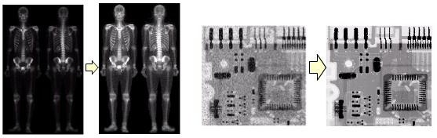
Image Enhancement
Process an image to make the result more suitable original image for a specific application
than the
The reasons for doing this include:
  Highlighting interesting details in the image
  Removing noise from images
  Making images visually more appealing
Image enhancement is subjective (problem /application oriented)

Slide 2
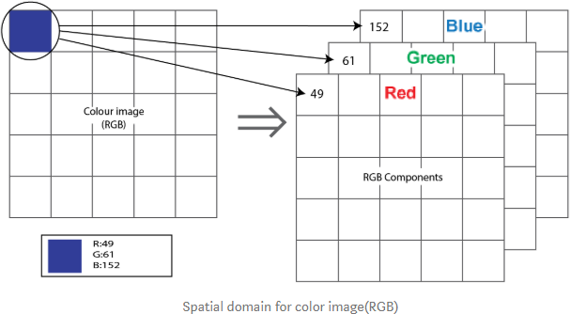
Content
Filtering
1. Fundamental of spatial filtering
Spatial Domain
Frequency Domain
Linear Filters
Smoothing Filters
  Average Filter
  Gaussian Filtering
Nonlinear Filter
  Median filter
Sharpening Filters
  Laplacian Filter
Edge Detection
  Sobel Operators
Combining image enhancement methods
𝟏 |  | 𝟏 |  | 𝟏
𝟗 𝟏 |  | 𝟗 𝟏 |  | 𝟗 𝟏
𝟗 𝟏 |  | 𝟗 𝟏 |  | 𝟗 𝟏
𝟗 |  | 𝟗 |  | 𝟗
h =

Slide 3
Filtering is a fundamental operation in image processing. It can be used for:
image enhancement
Noise reduction
Edge detection,
Sharpening.
The concept of filtering has been applied in the:
Frequency domain, where it rejects some frequency components while accepting others.
Spatial domain, Spatial filtering modifies an image by replacing the value of each pixel with a function of the values of the pixel and its neighbors (filtering is pixel neighborhood operation).
  Commonly used spatial filtering techniques include median, average, Gaussian filtering, etc.
  The filtering function sometimes is called filter mask, or filter kernel.
  They can be broadly classified into two different categories :
    Linear filtering.
    Nonlinear filtering ( Order-statistic filters).

Slide 4

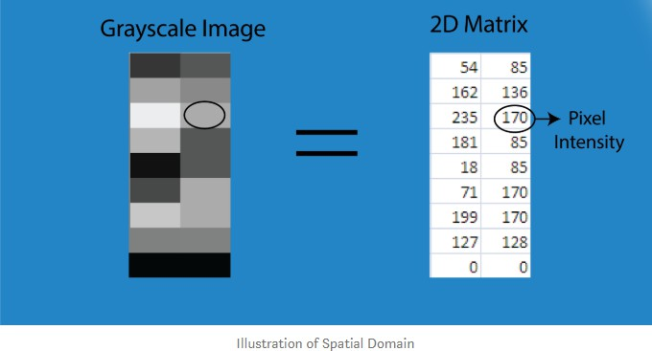
An image can be represented in the form of a 2D matrix where each element of the matrix represents pixel intensity.
This state of 2D matrices
that depict the
intensity distribution of an image is called Spatial Domain. It can be represented as shown below.
For the RGB image, the spatial domain is represented as a 3D vector of 2D matrices. Each 2D matrix contains the intensities for a single color as shown below.
Each pixel intensity is represented as I(x, y) where x, y is the co-ordinate of the pixel in the 2D matrix. Different operations are carried out in this value.

Slide 5

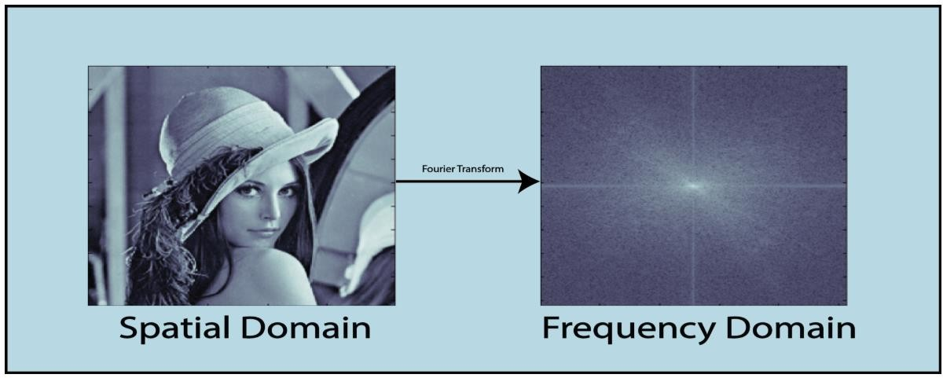
In frequency-domain methods are based on the Fourier Transform of an image.
Roughly, the term frequency in an image tells about the rate of change of pixel values.
The tie between spatial- and frequency-domain processing is the Fourier transform.
We use the Fourier transform to go from the spatial
To the frequency domain; to return to the spatial domain we use the inverse Fourier transform.
The figure below depicts the conversion of the image from the spatial domain to the frequency domain using Fourier Transformation.

Slide 6

A linear spatial filter performs a sum-of-products operation between an image f and a filter kernel, w.
The kernel is an array whose size defines the neighborhood of operation, and whose coefficients determine the nature of the filter.
Other terms used to refer to a spatial filter kernel are mask, template, and window.
We use the term filter kernel or simply kernel.
The equation below illustrates the mechanics of linear spatial filtering using a kernel. At any point (x, y) in the image, the response, g(x, y), of the filter, is the sum of products of the kernel coefficients and the image pixels encompassed by the kernel:
g (x , y ) = w ( − 1, − 1) f ( x-1, y− 1) + w ( − 1, 0) f ( x − 1, y ) +
… + w (0, 0) f (x , y ) + … + w(1, 1) f ( x +1, y + 1)
As coordinates x and y are varied, the center of the kernel moves from pixel to pixel, generating the filtered image, g, in the process

Slide 7
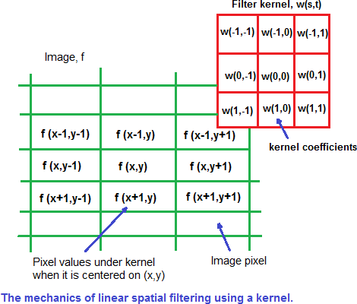
Observe that the center coefficient of the kernel, w(0, 0), aligns with the pixel at location (x, y).
This means that our focus is on kernels of odd size in both coordinate directions.
In general, linear spatial filtering of an image of size MxN with a kernel of size mxn is given by the expression
where x and y are varied so that the center (origin) of the kernel visits every pixel in f once.

Slide 8
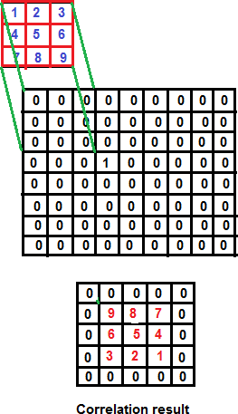
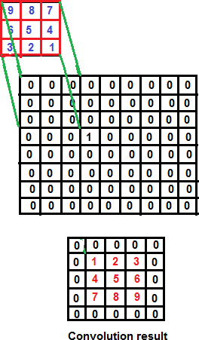
Correlation consists of moving the center of a kernel over an image, and computing the sum of products at each location.
We used correlation to check
similarity between two image
𝒂
𝒈(𝒙, 𝒚) = ∑
𝒃
∑ 𝒘 𝒔, 𝒕 𝒇(𝒙 + 𝒔, 𝒚 + 𝒕)
𝒔=−𝒂 𝒕=−𝒃
The mechanics of spatial convolution are the same, except that the correlation kernel is rotated by 𝟏𝟖𝟎◦. Thus, when the values of a kernel are symmetric about its center, correlation and convolution yield the same result.

Slide 9
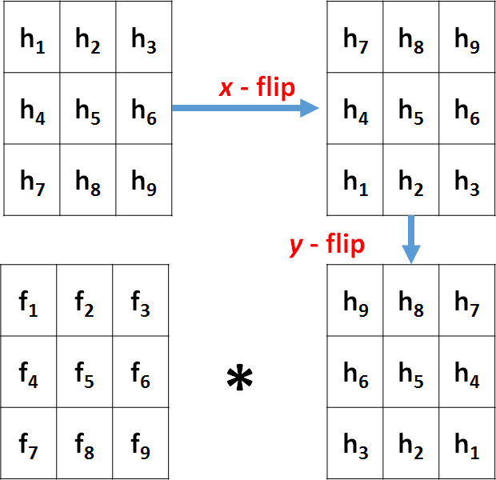
Convolution
Convolution is very similar to correlation, the only difference is flipped kernel.

Slide 10
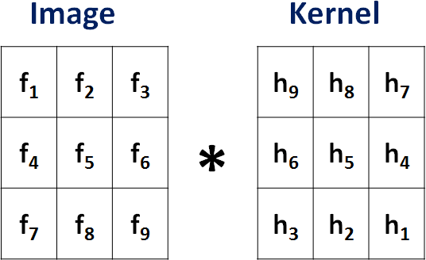
Convolution
F ∗ H = f₁h₉ + f₂h₈ + f₃h₇
+f₄h₆ + f₅h₅ + f₆h₄
+f₇h₃ + f₈h₂ + f₉h₁
(7)
37 / 68

Slide 11
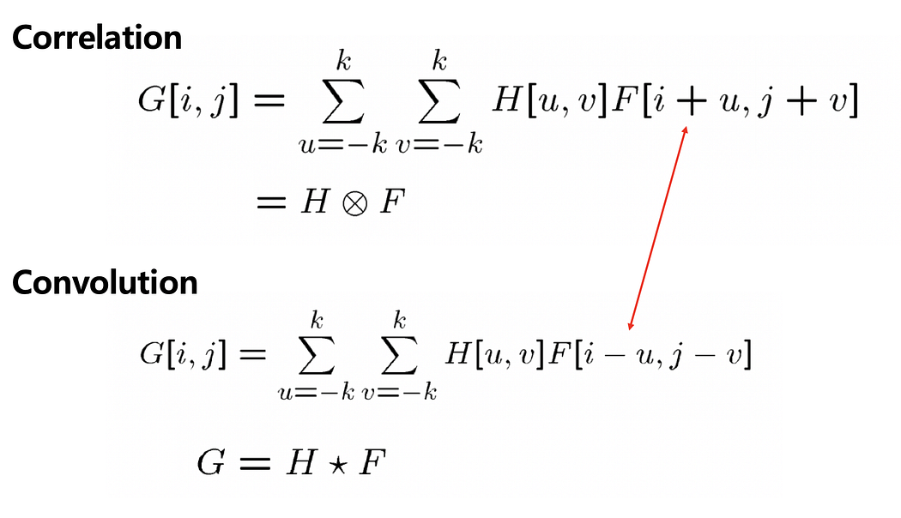

Slide 12

Smoothing (also called averaging) spatial filters are used to reduce sharp transitions in intensity.
Because random noise typically consists of sharp transitions in intensity, an obvious application of smoothing is noise reduction.
Smoothing prior to image resampling to reduce aliasing, is also a common application.
The commonly used smoothing filters are Averaging and Gaussian filters.
It can be performed using the convolution operation.

Slide 13


The average filtering is also called mean filtering. Where the output pixel value is the mean of its neighborhood. Thus, the filtering mask is as follows (3*3 as an example).
𝟏 |  | 𝟏 |  | 𝟏
𝟗 𝟏 |  | 𝟗 𝟏 |  | 𝟗 𝟏
𝟗 𝟏 |  | 𝟗 𝟏 |  | 𝟗 𝟏
𝟗 |  | 𝟗 |  | 𝟗
h =
In practice, the size of the mask controls the degree of smoothing and loss
of the details
Example :
Used average filter to smooth sub image as shown
6 | 8 | 9 | 10 | 12
7 | 15 | 6 | 14 | 13
3 | 7 | 5 | 9 | 3
14 | 16 | 10 | 7 | 8

Slide 14








Answer :
(6*1/9) +(8*1/9) +(9*1/9) +(7*1/9) +(15*1/9) +(6*1/9)
+(3*1/9) +(7*1/9) +(5*1/9) =7.33
OR (6+8+9+7+15+6+3+7+5)/9 =7.33
1/9 | 1/9 | 1/9
1/9 | 1/9 | 1/9
1/9 | 1/9 | 1/9
6 | 8 | 9 | 10 | 12
7 | 15 | 6 | 14 | 13
3 | 7 | 5 | 9 | 3
14 | 16 | 10 | 7 | 8
6 | 8 | 9 | 10 | 12
7 | 7.33 |  |  | 13
3 |  |  |  | 3
14 | 16 | 10 | 7 | 8
(8*1/9) +(9*1/9) +(10*1/9) +(15*1/9) +(6*1/9) +(14*1/9)
+(7*1/9) +(5*1/9) +(9*1/9) =9.22
OR (8+9+10+15+6+14+7+5+9)/9 =9.22
1/9 | 1/9 | 1/9
1/9 | 1/9 | 1/9
1/9 | 1/9 | 1/9
6 | 8 | 9 | 10 | 12
7 | 15 | 6 | 14 | 13
3 | 7 | 5 | 9 | 3
14 | 16 | 10 | 7 | 8
6 | 8 | 9 | 10 | 12
7 | 7.33 | 9.22 |  | 13
3 |  |  |  | 3
14 | 16 | 10 | 7 | 8

Slide 15
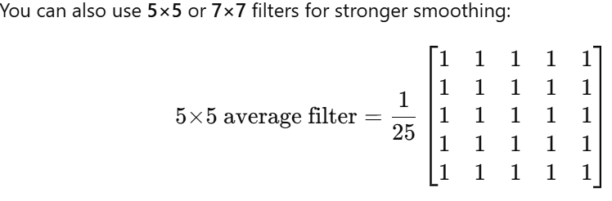

Slide 16

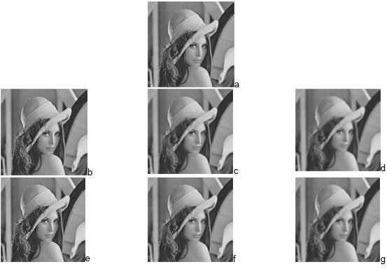

A Gaussian filter is a weighted average filter, where nearby pixels have more influence than distant ones.
Where: is the variance and controls the degree of smoothing.
The larger value is, the larger degree smoothing can be achieved.

Slide 17
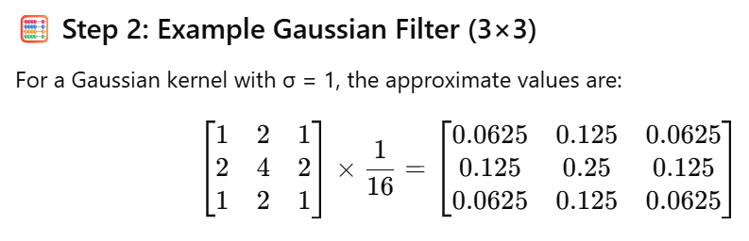

Slide 18
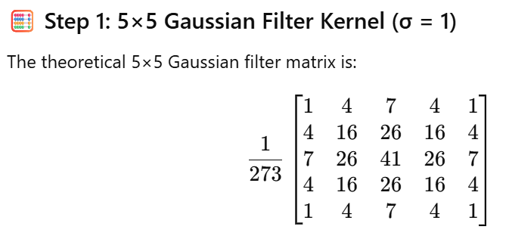

Slide 19

The order-statistical filters are usually non-linear filters, which are hardly represented by convolution.
The value of a given pixel in the output image is represented by some statistic within its support neighborhood in the original image, such as the median filter.
There are some other filters as well such as the max/min filter.
The median filter simply replaces the value of the pixel with the
median value within its neighborhood.
The max/min filter replaces the value of the pixel with the maximum/minimum value within its neighborhood.
Those filters are normally non-linear and cannot be easily implemented in the frequency domain.

Slide 20
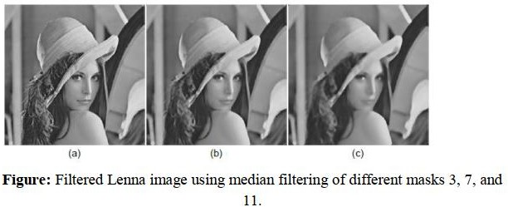
However, the common elements of a filter are:
( 1 ) A neighborhood
( 2) An operation on the neighborhood include the pixel itself.
Typically the neighborhood is a rectangular of different size, for example 3x3, 5x5 … and smaller than the image itself.
Figure below shows the filtered image using a median filter of different mask sizes.

Slide 21

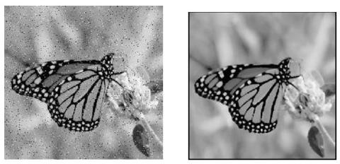
The median filter is a non-linear filter (order filter). These filters are based on as specific type of image statistics called order statistics.
Typically, these filters operate on small sub image, “Window”, and replace the center pixel value (similar to the convolution process).
Order statistics is a technique that arranges the entire pixel in sequential order, given an NxN window (W) the pixel values can be ordered from smallest to the largest.
I1 ≤ I2 ≤ I3...…………………< IN
Where: I1, I2, I3...……, IN
are the intensity values of the subset of pixels in the image.

Slide 22
Example:
Given the following 3X3 neighborhood :
Sort the value in order of size (3,3,4,4,5,5,5,6,7) .
Select the middle value , un this case it is 5.
This 5 is then placed in center location.
A median filter can use a neighborhood of any size, but 3X3, 5X5 and 7X7 are typical.
Note that the output image must be written to a separate image (a buffer); so that the results are not corrupted as this process is performed. (The median filtering operation is performed on an image by applying the sliding window concepts, similar to what is done with convolution).
The window is overlaid on the upper left corner of the image, and the median is determined. This value is put into the output image (buffer) corresponding to the center location of the window. The window is then slide one pixel over, and the process is repeated.
5 | 5 | 6
3 | 4 | 5
3 | 4 | 7

Slide 23
Example 1:
Using median filters to remove salt and pepper noise, from sub image I(r , c).
First pixel:
Rearrange the 3x3 neighbor pixels in
ascending way such as:
2, 5, 16, 19, 20, 21, 25, 43, 51
By using median filter we select the median value 20 and put it in buffer image in the position (1,1)
Second pixel:
  Rearrange the 3x3 neighbor pixels in
ascending way such as:
2, 15, 16, 18, 19, 20, 23, 25, 51
  By using median filter we select the median value 19 and put it in buffer image in the position (1,1)
5 | 16 | 20 | 15 | 17 | 20
21 | 2 | 25 | 23 | 34 | 19
43 | 51 | 19 | 18 | 40 | 42
15 | 18 | 25 | 23 | 38 | 40
52 | 44 | 34 | 12 | 10 | 13
5 | 16 | 20 | 15 | 17 | 20
21 | 20 | ? | ? | ? | 19
43 | ? | ? | ? | ? | 42
15 | ? | ? | ? | ? | 40
52 | 44 | 34 | 12 | 10 | 13
5 | 16 | 20 | 15 | 17 | 20
21 | 20 | 19 | ? | ? | 19
43 | ? | ? | ? | ? | 42
15 | ? | ? | ? | ? | 40
52 | 44 | 34 | 12 | 10 | 13

Slide 24
Example 2:
Using min. filters to remove salt and pepper noise, from sub image I(r , c).
First pixel:
Rearrange the 3x3 neighbor pixels in
ascending way such as:
5, 13, 16, 19, 20, 21, 25, 25, 43, 51
By using min. filter we select the minimum value 5 and put it in buffer image in the position (1,1)
Second pixel:
  Rearrange the 3x3 neighbor pixels in ascending way such as:
13,15,16,19,20,22,23,25,51
  By using min. filter we select the minimum value 13 and put it in buffer image in the position (1,1)
5 | 16 | 20 | 15 | 17 | 20
21 | 13 | 25 | 23 | 34 | 19
43 | 51 | 19 | 22 | 40 | 42
15 | 18 | 25 | 23 | 38 | 40
52 | 44 | 34 | 12 | 10 | 13
5 | 16 | 20 | 15 | 17 | 20
21 | 5 | ? | ? | ? | 19
43 | ? | ? | ? | ? | 42
15 | ? | ? | ? | ? | 40
52 | 44 | 34 | 12 | 10 | 13
5 | 16 | 20 | 15 | 17 | 20
21 | 5 | 13 | ? | ? | 19
43 | ? | ? | ? | ? | 42
15 | ? | ? | ? | ? | 40
52 | 44 | 34 | 12 | 10 | 13

Slide 25
Example 3:
Using max. filters to remove salt and pepper noise, from sub image I(r , c).
First pixel:
Rearrange the 3x3 neighbor pixels in
ascending way such as:
5,13,16,19,20, 21,25,25,43,51
By using max. filter we select the maximum value 51 and put it in buffer image in the position (1,1)
Second pixel:
  Rearrange the 3x3 neighbor pixels in ascending way such as:
13,15,16,19,20,22,23,25,51
  By using max. filter we select the maximum value 51 and put it in buffer image in the position (1,1)
5 | 16 | 20 | 15 | 17 | 20
21 | 13 | 25 | 23 | 34 | 19
43 | 51 | 19 | 22 | 40 | 42
15 | 18 | 25 | 23 | 38 | 40
52 | 44 | 34 | 12 | 10 | 13
5 | 16 | 20 | 15 | 17 | 20
21 | 51 | ? | ? | ? | 19
43 | ? | ? | ? | ? | 42
15 | ? | ? | ? | ? | 40
52 | 44 | 34 | 12 | 10 | 13
5 | 16 | 20 | 15 | 17 | 20
21 | 51 | 51 | ? | ? | 19
43 | ? | ? | ? | ? | 42
15 | ? | ? | ? | ? | 40
52 | 44 | 34 | 12 | 10 | 13

Slide 26



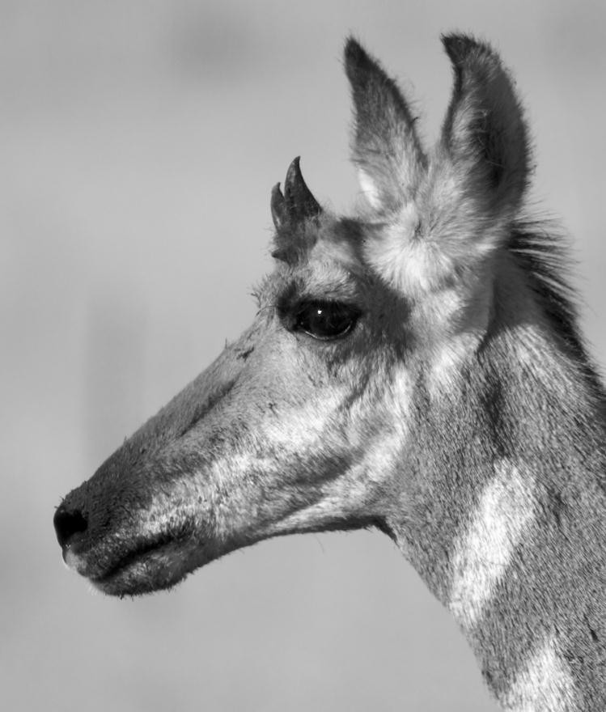
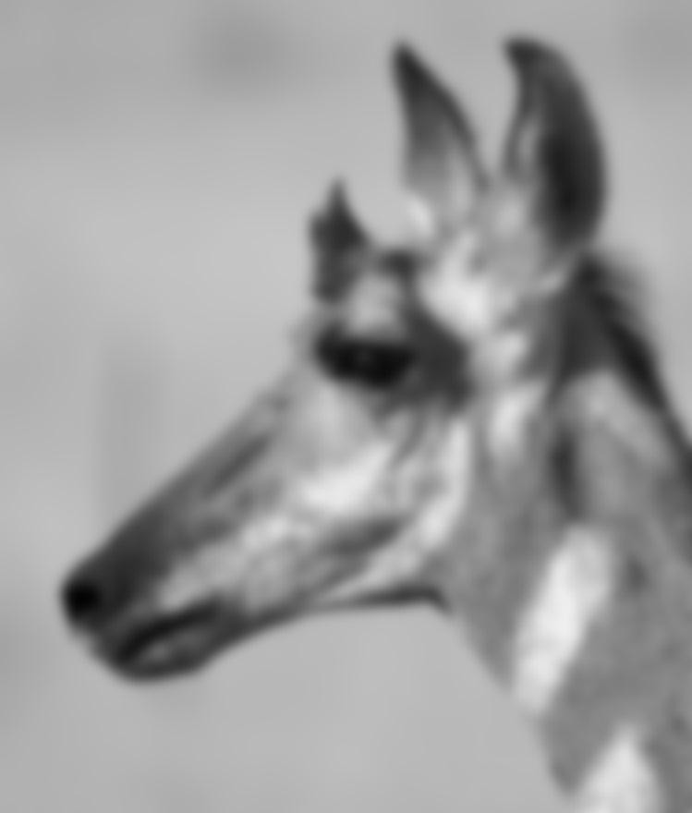
Blurring / Smoothing

Slide 27



Sharpening

Slide 28

The objective of sharpening is to draw attention to the fine details of an image. This is also related to the situation where an image that has been blurred and now needs to be de-blurred.
In contrast to the process of image :
Smoothing that normally uses pixel averaging techniques, Sharpening can be conducted using spatial differentiation.
The image differentiation actually:
Enhances edges
Discontinuities
Depresses the areas of slowly changing gray-level values.
The Sharpening filter indicates the filter should have positive coefficients near its center and negative coefficients in the outer periphery.

Slide 29
Image Differentiation (First-order Derivatives)
Image differentiation is a fundamental operation in spatial domain filtering.
It works by computing changes in intensity between neighbouring pixels.
So, differentiation highlights:
✔ Object boundaries
✔ Sharp transitions
✔ Lines and corners
Discontinuities are sudden jumps in intensity, even if they are not classical edges.

Slide 30

The first-order derivative of a one-dimensional function f(x) is the difference
^{∂f} = f (x +1) − f (x)
∂x
The second-order derivative of f(x) as the difference
∂² f ₌
f (x +1) + f (x −1) − 2 f (x)
∂x²

Slide 31
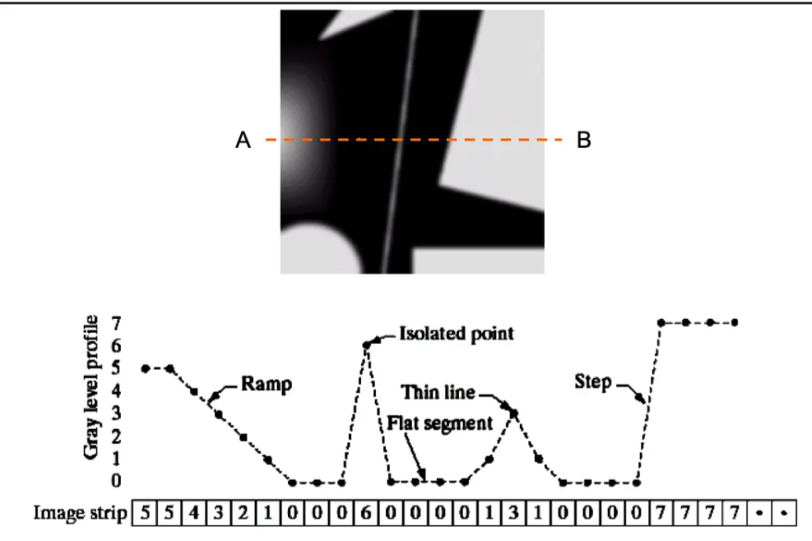

Slide 32
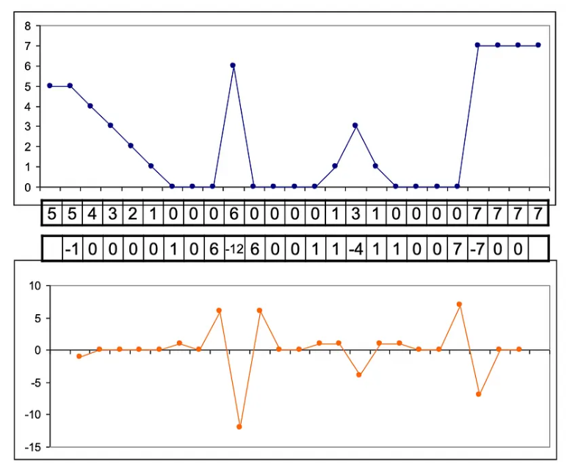

Slide 33
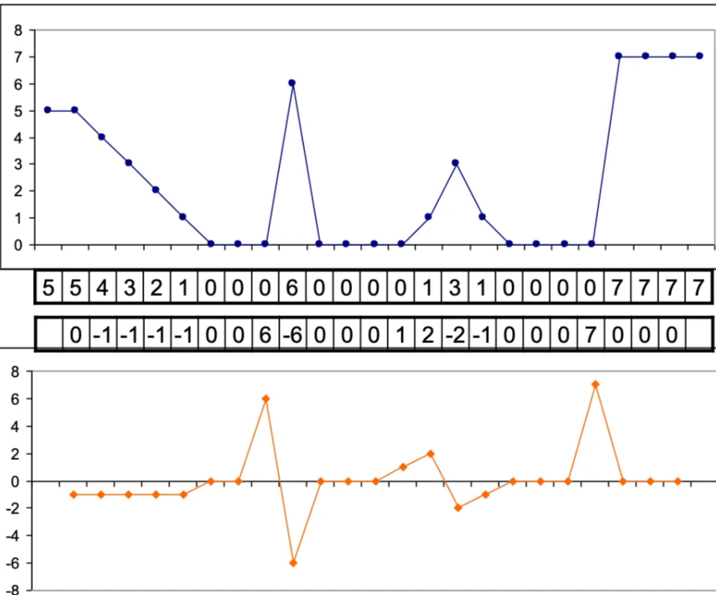

Slide 34
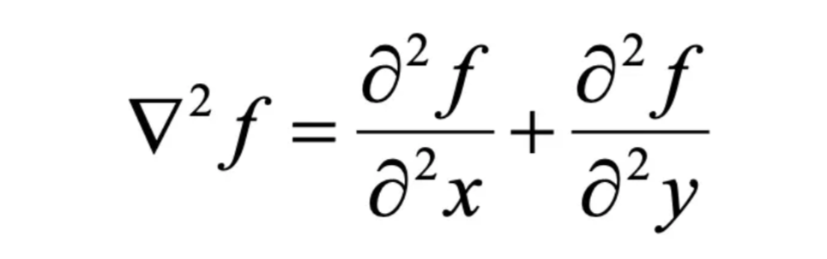
Sharpening Filters
The Laplacian Filter
The Laplacian filter has an isotropic structure.

Slide 35
The Laplacian Filter
∇2
∂² f ∂² f
f = _{∂x2}
⁺ ∂y²
∂² f ₌
f (x +1, y) + f (x −1, y) − 2 f (x, y)
f (x, y +1) + f (x, y −1) − 2 f (x, y)
∂x²
∂² f ₌
∂y²
∇² f = f (x +1, y) + f (x −1, y) + f (x, y +1) + f (x, y −1)
- 4 f (x, y)

Slide 36

These filters will tend to bring out, or enhance details in the image. Example of convolution masks for the Laplacian-type filters are:
0 | -1 | 0
-1 | 4 | -1
0 | -1 | 0
0 | 1 | 0
1 | -4 | 1
0 | 1 | 0
-1 | -1 | -1
-1 | 8 | -1
-1 | -1 | -1
1 | 1 | 1
1 | -8 | 1
1 | 1 | 1
Rotating by 90 Rotating by 45
4-neighbor Laplacian: 8-neighbor Laplacian:
The sum of the coefficients in this kernel is zero, this mean that:
when the kernel is over an area of constant (background area) or slowly varying gray level, the result of convolution is zero or some very small number.
when gray level is varying rapidly within the neighborhood, the result of the convolution can be large number.
This number can be positive or negative, because the kernel contains both positive and negative coefficients; we therefore need to choose an output image representation that supports negative number.

Slide 37
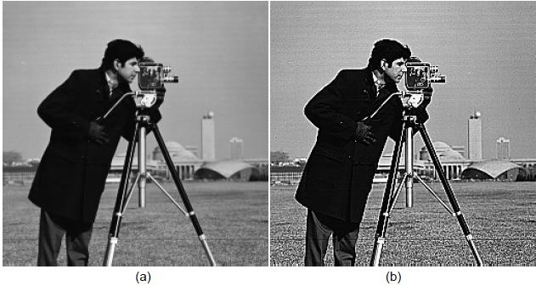
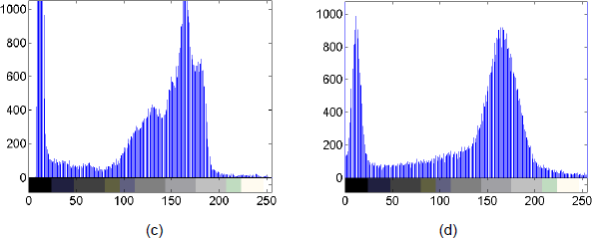
The main advantage of Laplacian filter is to increase the degree of sharpening. It enhance details in all directions equally.
Image sharpening and
histograms :
(a) original image ( c ) histogram
(b) sharpened image
(d) histogram .

Slide 38

Edge detection operators are based on the idea that edge information in an image is found by looking at the relationship a pixel has with its neighborhood.
If a pixel’s gray level value is similar to those around it, there is probably not an edge at that point.
If a pixel has a neighbor with widely varying gray levels, it may represent
an edge point.
In other words, an edge is defined by a discontinuity in gray-level. Ideally, an edge separates two distinct objects.
Definitions:
Edge is a location in an image where there is a sudden variation in the gray level or color of pixels.
Edge is a collection of pixel values whose brightness value changes
abruptly.
Edges represent borders between regions on an object or in a scene.

Slide 39
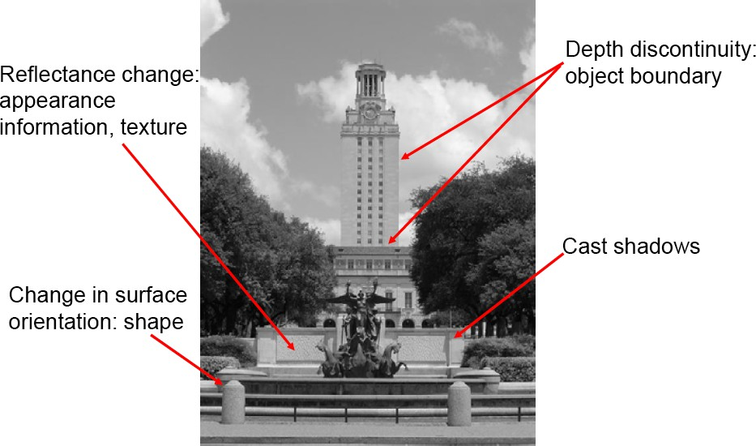
What Causes an Edge?

Slide 40
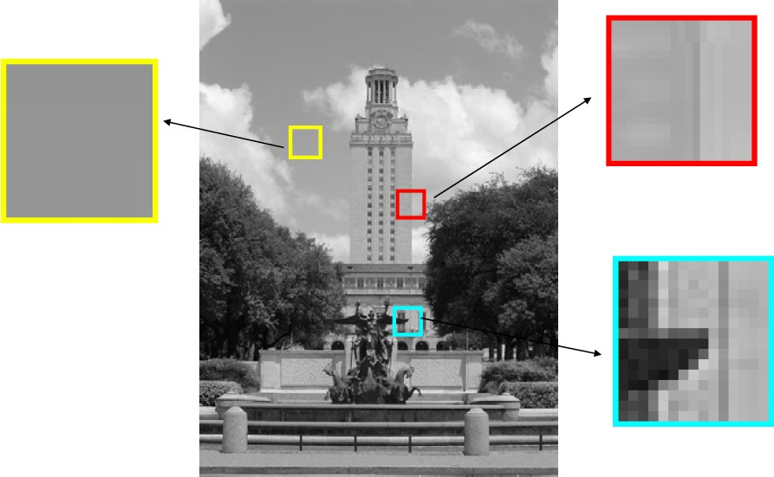
Looking More Locally...

Slide 41

The Sobel edge detection masks look for edges in both the horizontal and vertical directions and then combine this information into a single metric.
The masks are as follows:
-1 | -2 | -1
0 | 0 | 0
1 | 2 | 1
-1 | 0 | 1
-2 | 0 | 2
-1 | 0 | 1
Row Mask
Column Mask
These masks are each convolved with the image. At each pixel location we now have two numbers:
S1, corresponding to the result form the row mask.
S2, corresponding to the result from the column mask.
We use this numbers to compute two matrices, the edge magnitude and the edge direction, which are defined as follows:
𝑬𝒅𝒈𝒆 𝑴𝒂𝒈𝒏𝒊𝒕𝒖𝒅𝒆 = 𝒔^{𝟐} + 𝒔^{𝟐}
𝟏
𝑬𝒅𝒈𝒆 𝑫𝒊𝒓𝒆𝒄𝒕𝒊𝒐𝒏 = 𝒕𝒂𝒏^{−𝟏 𝒔𝟐}
𝒔_{𝟏}
𝟐

Slide 42
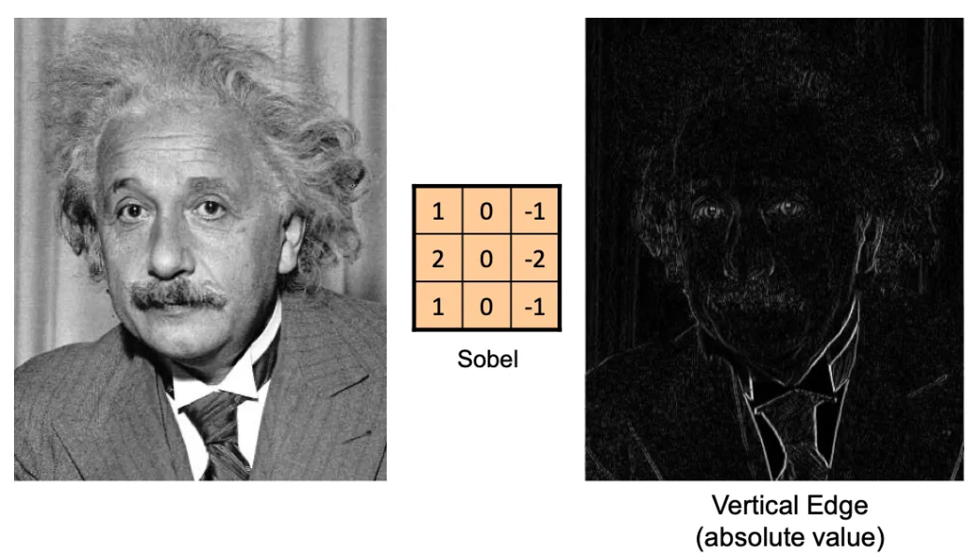

Slide 43
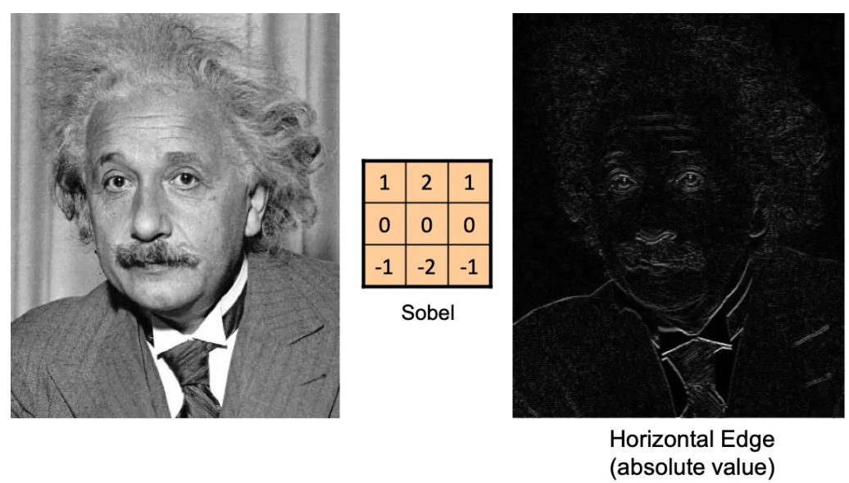

Slide 44
Example:
Compute the convolution of the Sobel operators s1 and s2 with the image and show the edge magnitude image:
3 | 5 | 7
2 | 4 | 3
1 | 8 | 6
3 | 5 | 7
2 | 11 | 3
1 | 8 | 6
Answer :
3 | 5 | 7
2 | 4 | 3
1 | 8 | 6
-1 | -2 | -1
0 | 0 | 0
1 | 2 | 1
= (3*-1 ) + ( 5*-2) + ( 7*-1) + (2*0) + (4*0) + (3*0)
+ ( 1*1) + (8*2) + ( 6*1) = -20+23= 3
Row Mask
= (3*-1 ) + ( 5*0) + ( 7*1) + (2*-2) + (4*0) + (3*2)
+ ( 1*-1) + (8*0) + ( 6*1) = 11
Column Mask
3 | 5 | 7
2 | 4 | 3
1 | 8 | 6
-1 | 0 | 1
-2 | 0 | 2
-1 | 0 | 1
𝑬𝒅𝒈𝒆 𝑴𝒂𝒈𝒏𝒊𝒕𝒖𝒅𝒆 = 𝒔^{𝟐} + 𝒔^{𝟐}
𝟏 𝟐
= 𝟑^{𝟐} + 𝟏𝟏^{𝟐}
= 𝟗 + 𝟏𝟐𝟏
= 𝟏𝟑𝟎 = 11.4
𝒔_{𝟐}
_{−𝟏} 𝟏𝟏
= 𝒕𝒂𝒏^{−𝟏}(𝟑. 𝟔)
𝑬𝒅𝒈𝒆 𝑫𝒊𝒓𝒆𝒄𝒕𝒊𝒐𝒏 = 𝒕𝒂𝒏^{−𝟏}
𝒔_{𝟏}
= 𝒕𝒂𝒏
𝟑

Slide 45
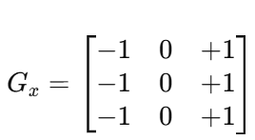
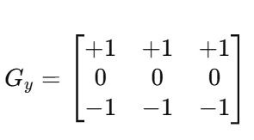
Prewitt Operator – Spatial Domain Filtering
The Prewitt operator is similar to the Sobel operator but uses uniform weights (no 2 in the center row/column).
It computes the gradient in the x and y directions.
Prewitt Mask in X-direction (Gx) Prewitt Mask in Y-direction (Gy)
Detects horizontal edges: Detects vertical edges:
These masks are each convolved with the image. At each pixel location we now have two numbers:
P1, corresponding to the result form the row mask.
P2, corresponding to the result from the column mask.

Slide 46
Prewitt Operator – Spatial Domain Filtering
We use this numbers to compute two matrices, the edge magnitude and the edge direction, which are defined as follows:
𝑬𝒅𝒈𝒆 𝑴𝒂𝒈𝒏𝒊𝒕𝒖𝒅𝒆 = P^{𝟐} + P^{𝟐}
𝟏
𝑬𝒅𝒈𝒆 𝑫𝒊𝒓𝒆𝒄𝒕𝒊𝒐𝒏 = 𝒕𝒂𝒏^{−𝟏 P𝟐}
_{P𝟏}
𝟐

Slide 47
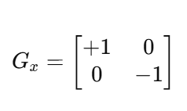
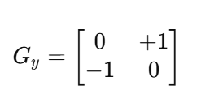
Roberts Operator – Spatial Domain Filtering
The Roberts Cross operator is one of the earliest edge-detection operators.
It uses 2×2 kernels to approximate the gradient in diagonal directions.
Roberts Mask in X-direction (Gx) Roberts Mask in Y-direction (Gy)
Detects Diagonal edges: Detects opposite Diagnonal
These masks are each convolved with the image. At each pixel location we now have two numbers:
R1, corresponding to the result form the row mask.
R2, corresponding to the result from the column mask.

Slide 48
Roberts Operator – Spatial Domain Filtering
We use this numbers to compute two matrices, the edge magnitude and the edge direction, which are defined as follows:
𝑬𝒅𝒈𝒆 𝑴𝒂𝒈𝒏𝒊𝒕𝒖𝒅𝒆 = R^{𝟐} + R^{𝟐}
𝟏
𝑬𝒅𝒈𝒆 𝑫𝒊𝒓𝒆𝒄𝒕𝒊𝒐𝒏 = 𝒕𝒂𝒏^{−𝟏 R𝟐}
_{R𝟏}
𝟐

Slide 49
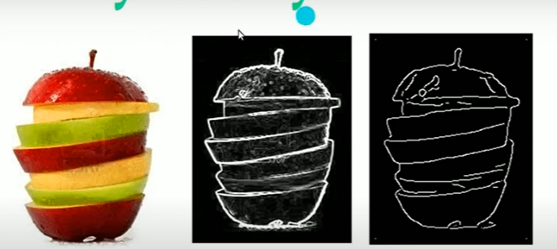
Canny Edge Detection
Five steps of canny edge detection
Noise Reduction (Gaussian Smoothing)
Gradient Calculation (Intensity Changes)
Non-Maximum Suppression (Thinning Edges)
Double Thresholding
Edge Tracking by Hysteresis

Slide 50
1.Noise Reduction
Since edge detection is susceptible to noise in image ,first steps is remove noise from image using gaussian filter.
2. Compute Image Gradient (Intensity Change)
Use Sobel filters in x and y directions:
-1 | -2 | -1
0 | 0 | 0
1 | 2 | 1
-1 | 0 | 1
-2 | 0 | 2
-1 | 0 | 1
Gy =
Gx =
𝑬𝒅𝒈𝒆 𝑴𝒂𝒈𝒏𝒊𝒕𝒖𝒅𝒆 = 𝒔^{𝟐} + 𝒔^{𝟐}
𝟏 𝟐
𝒔_{𝟐}
𝑬𝒅𝒈𝒆 𝑫𝒊𝒓𝒆𝒄𝒕𝒊𝒐𝒏 = 𝒕𝒂𝒏^{−𝟏}
𝒔_{𝟏}
Purpose:
Find regions with rapid intensity changes → edges.

Slide 51
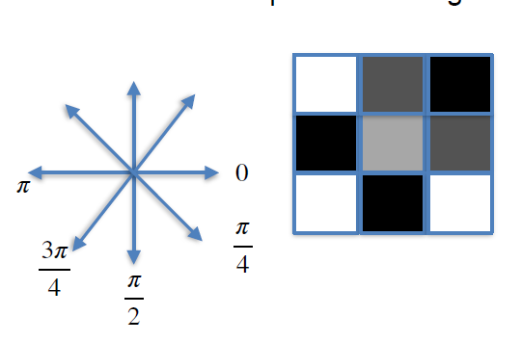
Non-Maximum Suppression (NMS)
Non-maximum suppression in the Canny edge detection algorithm works by examining each pixel's gradient magnitude and orientation and comparing it with the neighboring pixels along the gradient direction. If the central pixel's gradient magnitude is the largest among its neighbors, it means that this pixel is likely part of an edge, and we keep it. If not, we suppress it by setting its intensity to zero and removing it from consideration as an edge pixel.

Slide 52
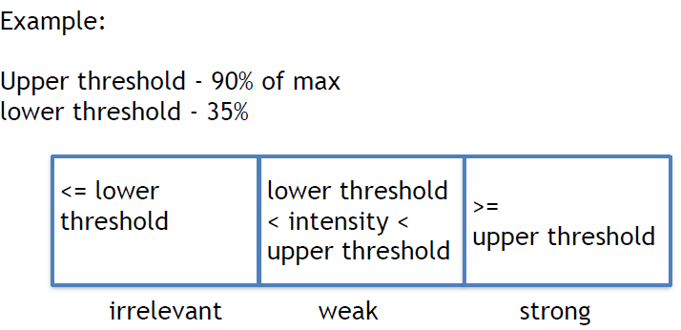
    Double thresholding
    Strong edges, weak edges, and non-edges
A high threshold and a low threshold are used for this purpose.
Strong edges
Pixels with gradient magnitudes above the high threshold are considered strong edges, indicating significant intensity changes.
weak edges
Pixels with gradient magnitudes between low threshold and high threshold are classified as weak edges. These weak edges may represent real edges or noise, and they need further verification.
non-edges
Pixels with gradient magnitudes below the low threshold are considered non-edges and are discarded.

Slide 53
Edge tracking by hysteresis
The last step of the Canny edge detection algorithm is edge tracking by hysteresis.
Hysteresis means 'remembering the past' to make our edges more accurate and reliable. This step aims to link weak edges that are likely part of real edges to the strong edges. Starting from each strong edge pixel, the algorithm traces the edge by considering its neighboring weak edge pixels that are connected. If a weak edge pixel is connected to a strong edge pixel, it is also considered part of the edge and retained. This process continues until no more weak edges are connected. This ensures that the edges are continuous and well-defined.

Slide 54
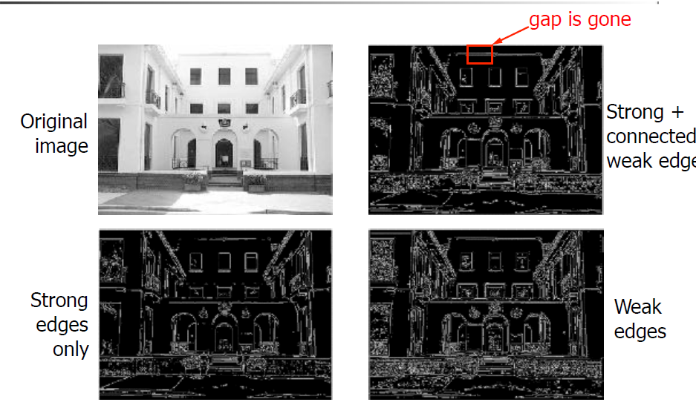

Slide 55
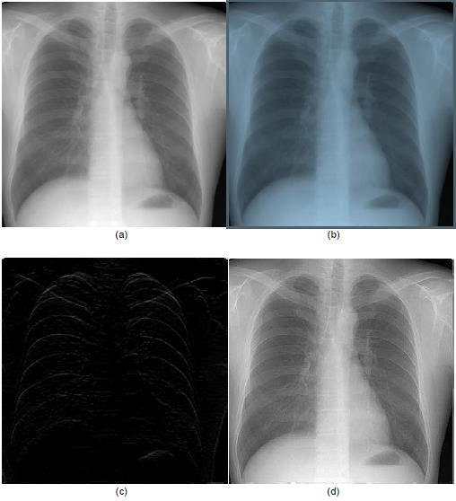
In real applications, it is hard to know what kind of noise has been added to an image.
Therefore, it is difficult to find a unique filter that can appropriately enhance this noisy image.
However, it is possible if several de-blurring methods can be combined in a framework in order to pursue a maximum demising outcome. We explain one of the combinatorial techniques using an X-ray example.
Figure (a) illustrates a male chest’s X-ray image. The purpose of the process is to highlight the middle cross section of the image using the combination of sharpening and edge detection.
Figure (b) shows the result of applying the median filter.
Figure (c) is the outcome of using Sobel edge detection. Figure (d) demonstrates the combination of the Laplacian and Sobel process.
Figure (d) shows the edge details in the graph, which highlights the structure of the central cross section of the image.

